Slide 1


Sarvajanik College of Engineering and Technology
Topic: Dynamic Memory Allocation
Subject: Computer Programming and Utilization(2110003)
Dept.: Computer Engineering (Shift-1)
Prepared By: Amul Luniya (48)
Yash Patel (44)
Darshit Akbari (45)
Jhanvi Desai (46)
Shreya Gamit (47)

Slide 2
Contents
Introduction
Dynamic Memory Allocation
Types of Memory Allocation
Malloc
Realloc
Calloc
Pointer to an array
Free
Memory errors
Why use Dynamic memory allocation?

Slide 3
Introduction
C dynamic memory allocation refers to performing manual memory management for dynamic memory allocation in the C programming language via a group of functions in the C standard library, namely malloc, realloc, calloc and free.

Slide 4
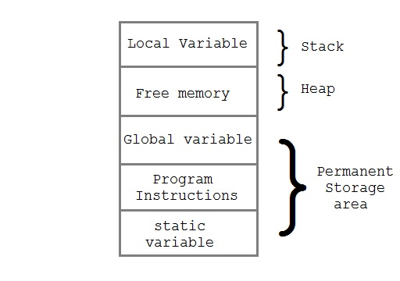

Slide 5
Dynamic memory allocation
The process of allocating memory at run time is known as dynamic memory allocation.
Free list: List of free blocks
Allocation algorithm: On request for allocation, choose a free block.
Fragmentation: Disconnected blocks of memory, all too small to satisfy the request.

Slide 6
Fragmentation
In a computer operating system, fragmentation is a consequence of allocating and freeing differently-sized blocks of data storage.
It results in the accumulation of small regions of free storage that are too small to be useful for allocation, even though in sum there may be more than sufficient free space

Slide 7
Types of memory allocation
Malloc
Alloc
Calloc
Stack Allocated
Heap Allocated
Semi-dynamic arrays

Slide 8
Stack-allocated memory
When a function is called, memory is allocated for all of its parameters and local variables.
Each active function call has memory on the stack (with the current function call on top)
When a function call terminates,
the memory is deallocated (“freed up”)
Ex: main() calls f(),
f() calls g()
g() recursively calls g()

Slide 9
Heap-allocated memory
This is used for persistent data, that must survive beyond the lifetime of a function call
global variables
dynamically allocated memory – C statements can create new heap data
Heap memory is allocated in a more complex way than stack memory

Slide 10
Semi-dynamic arrays
In some languages, one can have an array local to a procedure whose size is determined when the procedure is entered.
Eg:
M1, M2: array (1 .. N) of integer;

Slide 11
Malloc
Malloc is a tool for allocating memory dynamically in the C programming language. Without malloc, memory allocation must be done "at once".

Slide 12
Example
If we wish to create an array of ten integers, without malloc we may say – int tbl[10];
And with malloc, it is –
int * array = malloc(10 * sizeof(int));

Slide 13
Malloc
use of malloc allows us to create an array of any size
int *x;
x = malloc(sizeof(int)*10);
/* x can now be used as an array of ten integers */

Slide 14
or, If the array size isn't known until run time:
int *x = malloc(sizeof(int)*m); where m is a size determined dynamically
For example –
int *array = malloc(10 * sizeof(int));

Slide 15
Realloc
If you later determine that the size of the array has to be changed, you can use the realloc function to do this.
x = realloc(x, m2)
/* resize array to m2 elements */

Slide 16
Calloc
The calloc() function allocates memory for an array of nmemb elements of size bytes each and returns a pointer to the allocated memory. The memory is set to zero.
The C library function void *calloc(size_t nitems, size_t size) allocates the requested memory and returns a pointer to it.

Slide 17
The difference in malloc and calloc is that malloc does not set the memory to zero where as calloc sets allocated memory to zero.
Following is the declaration for calloc() function.
void *calloc(size_t nitems, size_t size)

Slide 18
Pointer to an array
Alternatively we can create a pointer to the first element of the array.
The following code will allow us to use either tbl or x to access data within the array.
int tbl[10];
int *x;
x = tbl;
/* tbl[i] and x[i] are now equivalent */

Slide 19
free
If you use malloc, then when you are done with the array, you have to free it:
This is done by using - free(x);
/* release the memory */
Example: strchrex.c week07

Slide 20
Memory errors
Using memory that you have not initialized
Using memory that you do not own
Using more memory than you have allocated
Using faulty heap memory management

Slide 21
Why use dynamic memory allocation?
Allows data (especially arrays) to take on variable sizes (e.g. ask the user how many numbers to store, then generate an array of integers exactly that size).
Allows locally created variables to live past end of routine.
Allows us to create many structures used in Data Structures and Algorithms

Slide 22
Thank You

